Slide 1


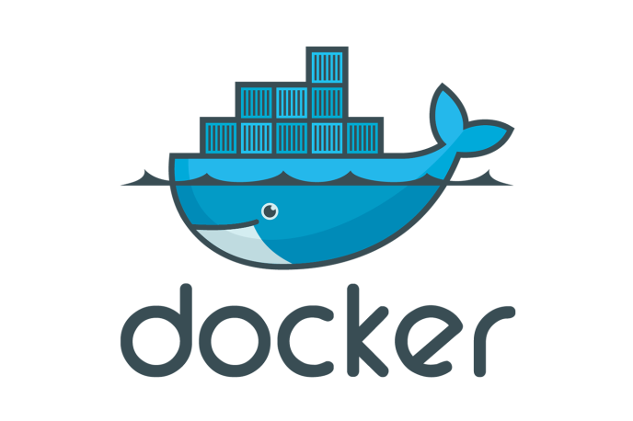
Docker Installation on the MAC
Introduction

Slide 2
Docker Installation on the MAC
The installation procedure here will cover installation of the following Software components
Downloading the Code Samples for exercises.
Installing Visual Studio Code and the Docker plugin on Visual Studio Code.
Installing Docker
Introduction

